Slide 1
Communication in OOP
Good Abstractions
Communication and cooperation
Associations
Documenting source code
Javadoc
Class Diagram
Notes:
Time: 5

Slide 2
Good Abstractions
A Class should do One thing and do it Well
Properties and Methods should define Domain of Class
A Good Abstraction:
Binds Properties and Methods Together
Limits the Scope for Future
Hides Members Irrelevant to other Classes
Avoids Duplicate Code by using Arrays, Methods and Loops
Frequent Static Methods Point to Bad Abstraction
Notes:
Time: 15
Advantages of good abstractions: Easy to understand the program, Easy to modify the program, Can reduce the size of the program
– Easy to identify and remember what the different parts of the program do.
– Promote reuse of code

Slide 3
Communication and Cooperation
Method Calls in Java
Make Objects Cooperate
Move Information using Parameters and Return Values
Delegate Work to Other Objects
Ownership of Objects
Owner Controls Lifespan
Notes:
Time: 15
Advantages of good abstractions: Easy to understand the program, Easy to modify the program, Can reduce the size of the program
– Easy to identify and remember what the different parts of the program do.
– Promote reuse of code

Slide 4
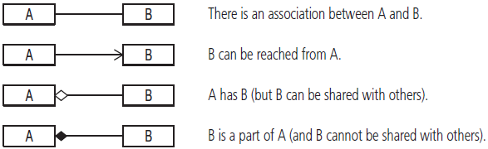
Associations
Is A Relationship
Has A Relationship
Dependency
Dependency is Bad. Use Top-level Objects Whenever Possible
Notes:
Time: 15
Advantages of good abstractions: Easy to understand the program, Easy to modify the program, Can reduce the size of the program
– Easy to identify and remember what the different parts of the program do.
– Promote reuse of code

Slide 5
Documenting Source Code
“Always code as if the guy who ends up maintaining your code will be a violent psychopath who knows where you live” [John F. Woods]
Use English Language
Method Names should Define “What” they do, not “How” they do it
What to Document
What Not to Document
Levels of Documentation: Class, Method, Member
Notes:
Time: 15
Advantages of good abstractions: Easy to understand the program, Easy to modify the program, Can reduce the size of the program
– Easy to identify and remember what the different parts of the program do.
– Promote reuse of code

Slide 6
Javadoc
Generates a Collection of HTML Document from Code Documentation
Try it. From Menu, go to Project > Generate Javadoc
Public, Protected, Package and Private
Notes:
Time: 15
Advantages of good abstractions: Easy to understand the program, Easy to modify the program, Can reduce the size of the program
– Easy to identify and remember what the different parts of the program do.
– Promote reuse of code

Slide 7
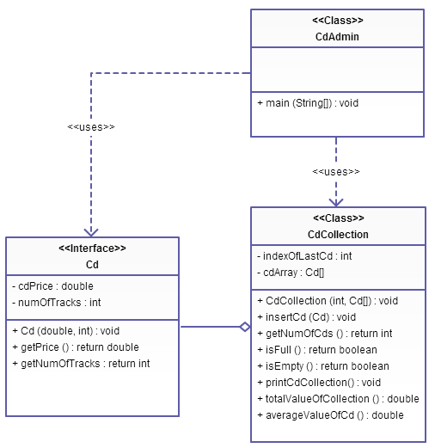
Class Diagram
Notes:
Time: 15
Advantages of good abstractions: Easy to understand the program, Easy to modify the program, Can reduce the size of the program
– Easy to identify and remember what the different parts of the program do.
– Promote reuse of code

